Slide 1
Extra slides: Single-Area OSPFv3
Instructor Materials
Notes:
Cisco Networking Academy Program
Scaling Networks v6.0
Chapter 8: Single-Area OSPF

Slide 2
Single-Area OSPFv3
Notes:
8 – Single-Area OSPF
8.3 – Single-Area OSPFv3

Slide 3
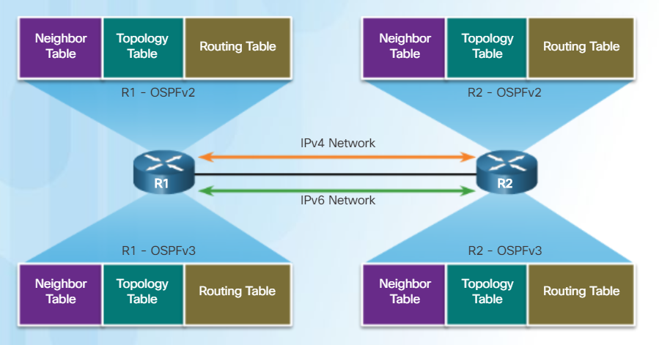
OSPFv2 vs. OSPFv3 OSPFv3
OSPFv3 is used to exchange IPv6 prefixes and build an IPv6 routing table.
OSPFv3 builds three OSPF tables – neighbor table, topology table, and routing table.
Notes:
8.3 – Single-Area OSPFv3
8.3.1 – OSPFv2 vs. OSPFv3
8.3.1.1 – OSPFv3

Slide 4
OSPFv2 vs. OSPFv3 Similarities Between OSPFv2 and OSPFv3
Feature | Comments
Link-State | Both are this type of routing protocol
Routing algorithm | Shortest Path First (SPF)
Metric | Cost
Areas | Both use and support a two-level hierarchy with areas connecting to Area 0
Packet types | Both use the same Hello, DBD, LSR, LSU, and LSAck packets
Neighbor discovery | Transitions through the same states using Hello packets
DR/BDR | Function and election process is the same
Router ID | Both use a 32-bit router ID; determined by the same process
Notes:
8.3 – Single-Area OSPFv3
8.3.1 – OSPFv2 vs. OSPFv3
8.3.1.2 – Similarities Between OSPFv2 to OSPFv3

Slide 5
OSPFv2 vs. OSPFv3 Differences Between OSPFv2 and OSPFv3
Feature | OSPFv2 | OSPFv3
Advertisements | IPv4 networks | IPv6 prefixes
Source address | IPv4 source address | IPv6 link-local address
Destination address | Choice of: Neighbor IPv4 unicast address 224.0.0.5 all-OSPF-routers multicast address 224.0.0.6 DR/BDR multicast address | Choice of: Neighbor IPv6 link-local address FF02::5 all-OSPF-routers multicast address FF02::6 DR/BDR multicast address
Advertise networks | Configured using the network router configuration command or ip ospf process-id area area-id interface configuration command | Configured using the ipv6 ospf process-id area area-id interface configuration command
IP unicast routing | IPv4 unicast routing is enabled by default | IPv6 unicast forwarding is not enabled by default. Use the ipv6 unicast-routing global configuration command to enable.
Authentication | Plain text and MD5 | IPv6 authentication (IPsec)
Notes:
8.3 – Single-Area OSPFv3
8.3.1 – OSPFv2 vs. OSPFv3
8.3.1.3 – Differences Between OSPFv2 and OSPFv3

Slide 6
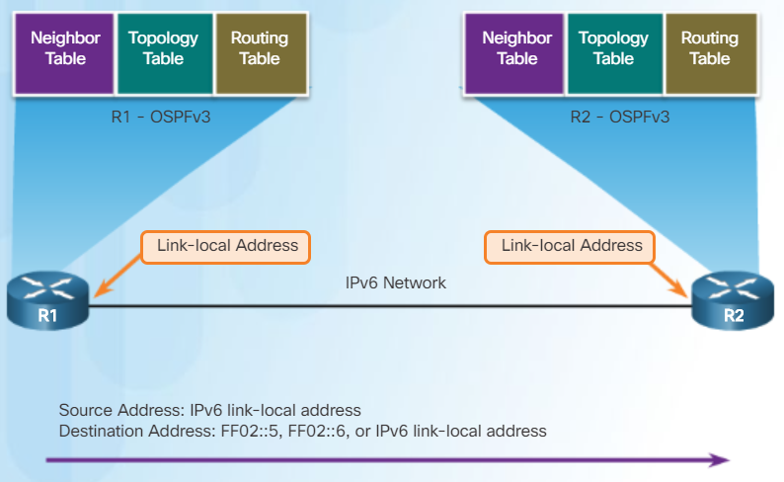
OSPFv2 vs. OSPFv3 Link-Local Addresses
An IPv6-link-local address enables a device to communicate with other IPv6-enabled devices on the same link and only on that link (subnet).
Packets with a source or destination link-local address cannot be routed beyond the link from where the packet originated.
IPv6 link-local address are used to exchange OSPFv3 messages
Notes:
8.3 – Single-Area OSPFv3
8.3.1 – OSPFv2 vs. OSPFv3
8.3.1.4 – Link-Local Addresses

Slide 7
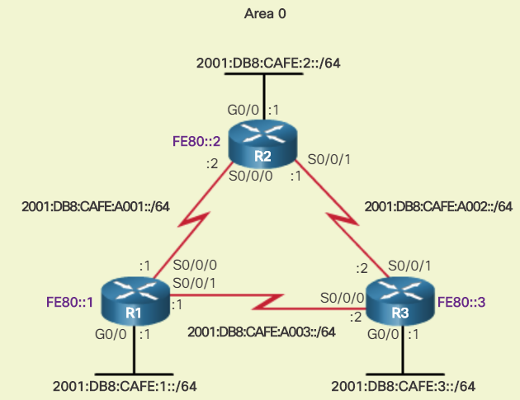
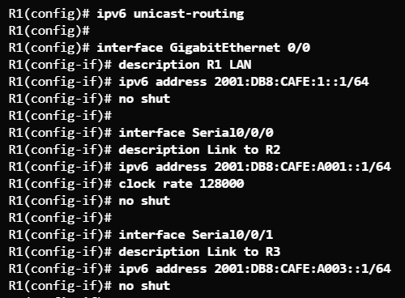
Configuring OSPFv3 OSPFv3 Network Topology
Be sure to turn on IPv6 routing and assign IPv6 addresses to interfaces before enabling OSPFv3.
The FE80 address on each router represents the link-local address assigned to each router.
Notes:
8.3 – Single-Area OSPFv3
8.3.2 – Configuring OSPFv3
8.3.2.1 – OSPFv3 Network Topology

Slide 8
Configuring OSPFv3 OSPFv3 Network Topology (Cont.)
Steps to Configure OSPFv3
Enable IPv6 unicast routing in global configuration mode – ipv6 unicast-routing
(Optional) Configure link-local addresses.
Configure a 32-bit router ID in OSPFv3 router configuration mode – router-id rid
Configure optional routing specifics such as adjusting the reference bandwidth.
(Optional, but optimum) Configure OSPFv3 interface specific settings such as setting the interface bandwidth on serial links.
Enable OSPFv3 routing in interface configuration mode – ipv6 ospf area
Notes:
8.3 – Single-Area OSPFv3
8.3.2 – Configuring OSPFv3
8.3.2.1 – OSPFv3 Network Topology (Cont.)

Slide 9
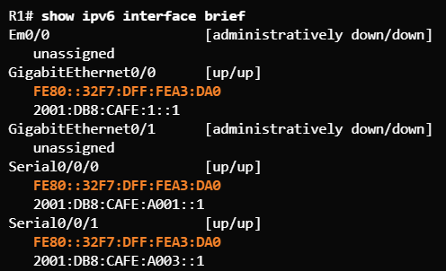
Configuring OSPFv3 Link-Local Addresses
Verify IPv6 addresses on interfaces.
Remember that link-local addresses are automatically created when an IPv6 global unicast address is assigned to an interface. However, IPv6 global unicast addresses are not required. Link-local addresses are required for OSPFv3.
Unless configured manually, Cisco routers create a link-local address using FE80::/10 prefix and the EUI-64 process by manipulating the 48-bit Ethernet MAC address.
Notes:
8.3 – Single-Area OSPFv3
8.3.2 – Configuring OSPFv3
8.3.2.2 – Link-Local Addresses

Slide 10
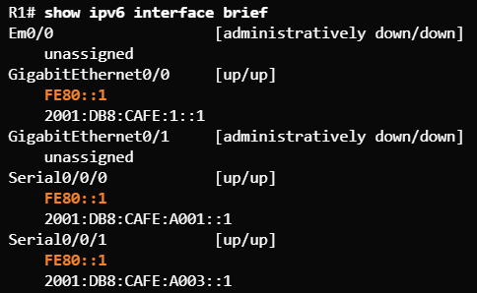
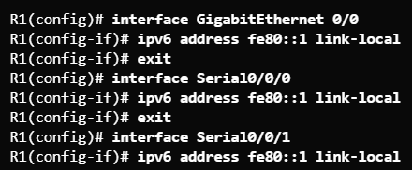
Configuring OSPFv3 Assigning Link-Local Addresses
Manually configuring link-local addresses make it easier to manage and verify OSPFv3 configurations.
Use the ipv6 address link-local interface command to apply.
Use the show ipv6 interface brief command to verify.
Notes:
8.3 – Single-Area OSPFv3
8.3.2 – Configuring OSPFv3
8.3.2.3 – Assigning Link-Local Addresses

Slide 11
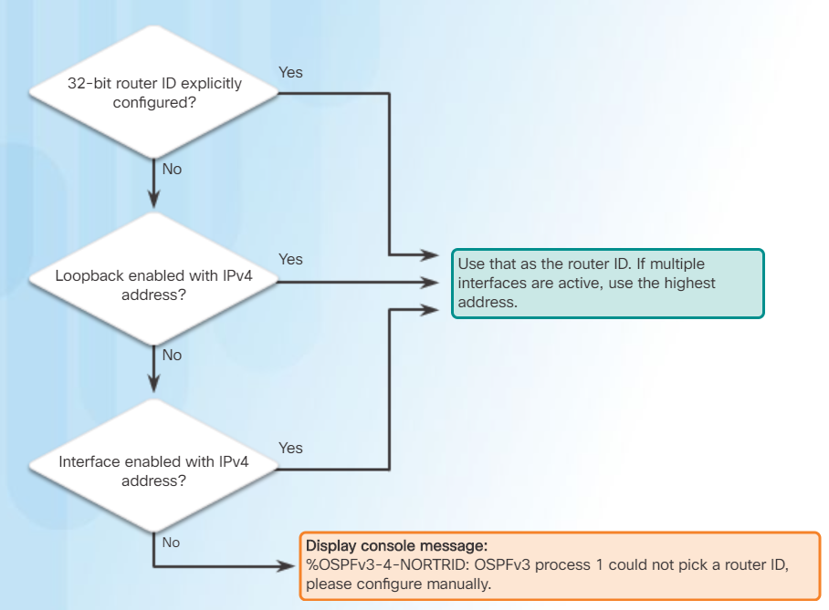
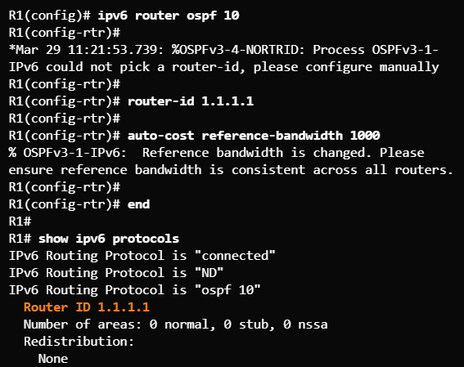
Configuring OSPFv3 Configuring the OSPFv3 Router ID
Use the ipv6 router ospf process-id global configuration command to enter router configuration mode.
Use the router-id rid command in router configuration mode to assign a router ID and use the show ipv6 protocols command to verify.
Notice the message
Same process as OSPFv2
Notes:
8.3 – Single-Area OSPFv3
8.3.2 – Configuring OSPFv3
8.3.2.4 – Configuring the OSPFv3 Router ID

Slide 12
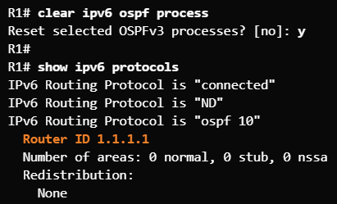
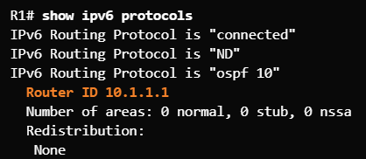

Configuring OSPFv3 Modifying an OSPFv3 Router ID
Use the clear ipv6 ospf process privileged EXEC mode command after changing the router ID to complete the router ID change and force a router to renegotiate neighbor adjacencies using the new router ID.
Commonly forgotten step
Original router ID
Change the router ID.
Complete the router ID change.
Notes:
8.3 – Single-Area OSPFv3
8.3.2 – Configuring OSPFv3
8.3.2.5 – Modifying an OSPFv3 Router ID

Slide 13
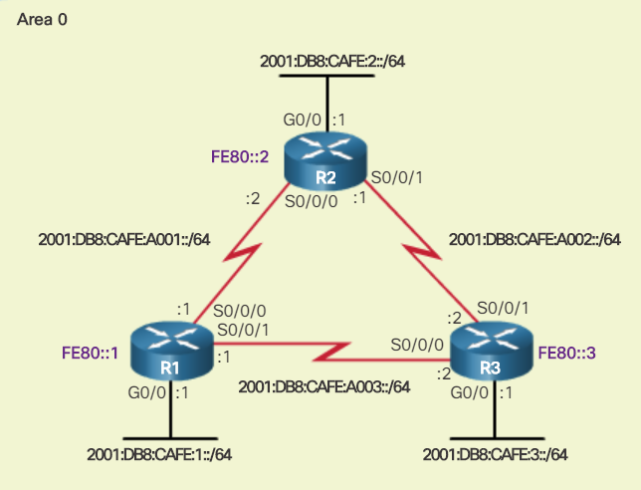
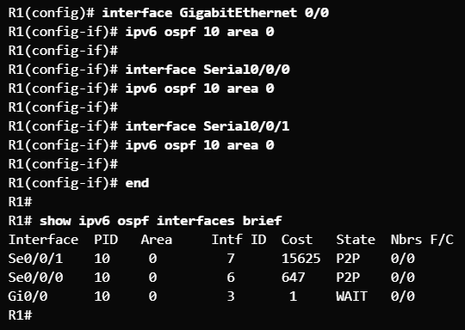
Configuring OSPFv3 Enabling OSPFv3 on Interfaces
Use the ipv6 ospf area interface configuration mode command to enable OSPFv3 on a specific interface. Ensure the interface is within an OSPF area.
Use the show ipv6 ospf interfaces brief command to verify.
Notes:
8.3 – Single-Area OSPFv3
8.3.2 – Configuring OSPFv3
8.3.2.6 – Enabling OSPFv3 on Interfaces

Slide 14
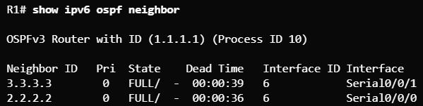
Verify OSPFv3 Verifying OSPFv3 Neighbors
Use the show ipv6 ospf neighbor command to verify neighbor connectivity with directly-connected routers.
Output | Description
Neighbor ID | The router ID of the neighbor router
Pri | The OSPFv3 priority of the interface used in the DR/BDR election process
State | The OSPFv3 state – Full means that the link-state database has had the algorithm executed and the neighbor router and R1 have identical LSDBs. Ethernet multi-access interfaces may show as 2WAY. The dash indicates that no DR/BDR is required.
Dead time | Amount of time remaining before expecting to receive an OSPFv3 Hello packet from the neighbor before declaring the neighbor down. This value is reset when a hello packet is received.
Address | The address of the neighbor’s directly-connected interface
Interface | The interface on R1 used to form an adjacency with the neighbor router
Notes:
8.3 – Single-Area OSPFv3
8.3.3 – Verify OSPFv3
8.3.3.1 – Verifying OSPFv3 Neighbors

Slide 15
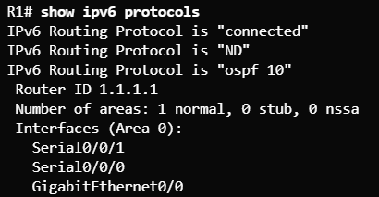
Verify OSPFv3 Verifying OSPFv3 Protocol Settings
Use the show ipv6 protocols command to verify vital OSPFv3 configuration information.
Notes:
8.3 – Single-Area OSPFv3
8.3.3 – Verify OSPFv3
8.3.3.2 – Verifying OSPFv3 Protocol Settings

Slide 16
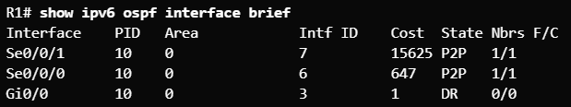
Verify OSPFv3 Verify OSPFv3 Interfaces
Use the show ipv6 ospf interface command to display a detailed list for every OSPFv3-enabled interface.
The show ipv6 ospf interface brief command is an easier output to verify which interfaces are being used with OSPFv3.
Notes:
8.3 – Single-Area OSPFv3
8.3.3 – Verify OSPFv3
8.3.3.3 – Verify OSPFv3 Interfaces

Slide 17
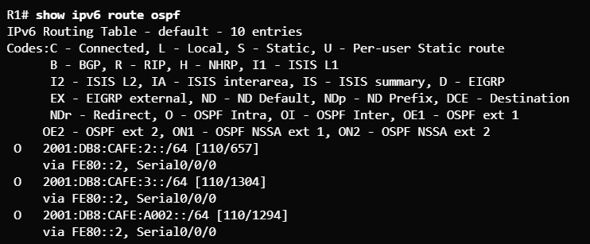
Verify OSPFv3 Verify The IPv6 Routing Table
Use the show ipv6 route command to see an IPv6 routing table.
Use the show ipv6 route ospf command to see just the OSPFv3 routes.
Notes:
8.3 – Single-Area OSPFv3
8.3.3 – Verify OSPFv3
8.3.3.4 – Verifying the IPv6 Routing Table

Slide 18
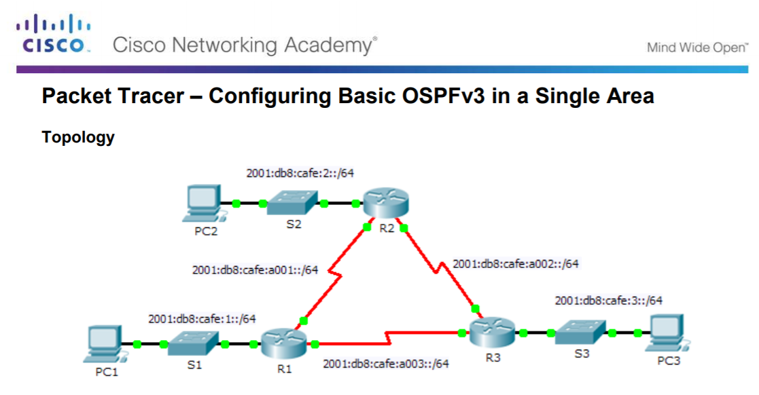
Verify OSPFv3 Packet Tracer - Configuring Basic OSPFv3
Notes:
8.3 – Single-Area OSPFv3
8.3.3 – Verify OSPFv3
8.3.3.5 – Packet Tracer – Configuring Basic OSPFv3

